Slide 1






Efficient Pizza Order Management Using SQL

Slide 2
Presented BY: Usman Shaikh

Slide 3



List of contents
Introduction
Objectives
Advanced SQL Queries
Database Structure
Project Tools
Table Structures
Results and Insights
SQL Queries
Conclusion
Intermediate SQL Queries
Contact Information

Slide 4



Introduction
The Pizza Order Management System is designed to streamline the process of managing pizza orders using a structured SQL database. This system efficiently tracks orders, organizes pizza types by size and ingredients, and provides insightful analysis of sales trends. By leveraging SQL queries, the project enables smooth data management, from simple order retrieval to advanced sales analytics.
Let’s dive into the world of pizza orders and sales management!

Slide 5


The goal of this project is to demonstrate how SQL can be used to optimize real-world business operations, such as order processing, inventory control, and sales performance tracking.
Objectives
Through the use of four interlinked tables—Orders, Order Details, Pizzas, and Pizza Types—this system provides a comprehensive view of all aspects of pizza sales and inventory.
The project covers simple, intermediate, and advanced SQL queries to manage and analyze pizza orders effectively.
This project also showcases a range of SQL queries that help solve various data management challenges, from basic data retrieval to more complex operations like subqueries, joins, and aggregations.
By efficiently organizing and analyzing pizza order data, this project aims to enhance business decision-making and operational efficiency.
Mozzarella, Parmesan or your favorite cheese

Slide 6

Ensure all orders and pizza details are ready before analyzing the sales data.

Slide 7
Database Structure
ER Diagram: Visual representation of the relationships between the four tables
01
02
Orders
Order Details
order_id, order_date, order_time.
order_details_id, order_id, pizza_id, quantity.
03
Pizzas
04
Pizza Types
pizza_id, pizza_type_id, size, price.
pizza_type_id, name, category, ingredients.

Slide 8
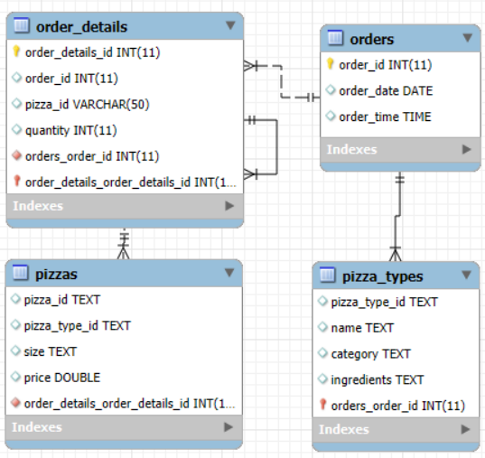
ER diagram

Slide 9
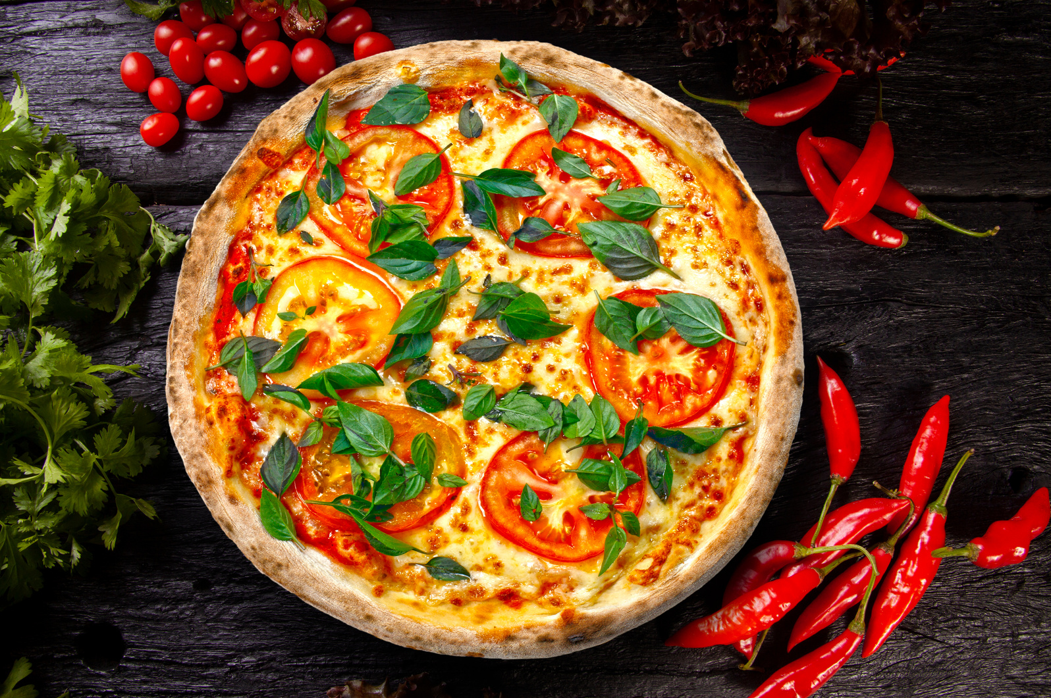
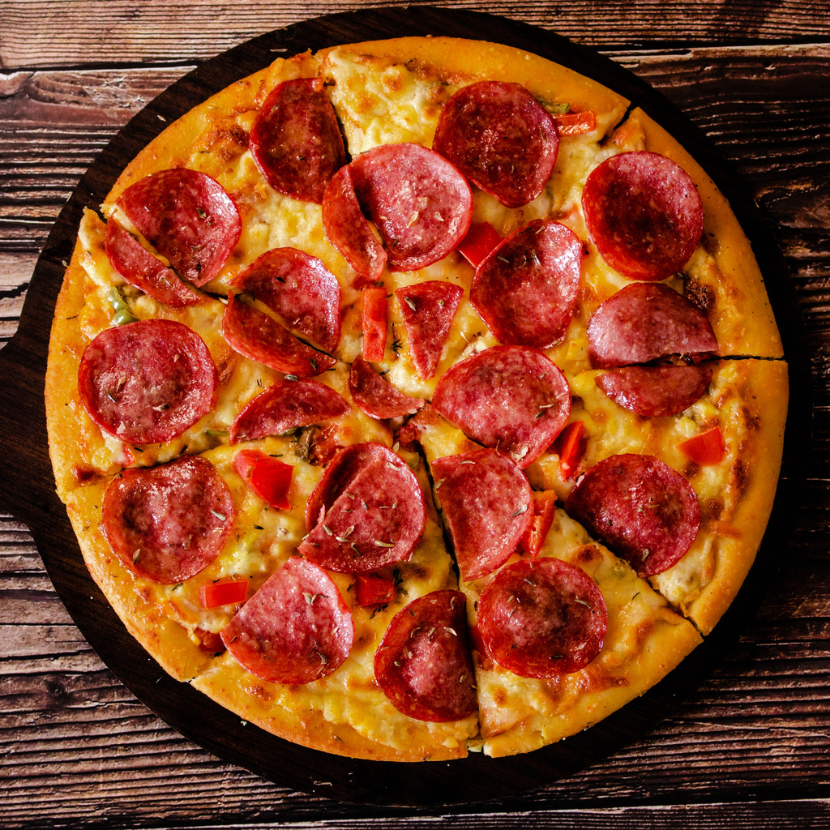
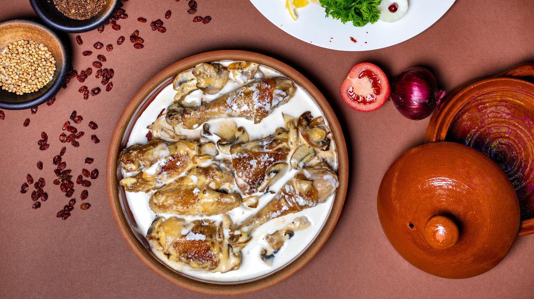
SQL Queries
Simple SQL Queries
Intermediate SQL Queries
Advanced SQL Queries

Slide 10


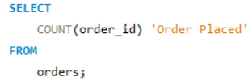
Simple SQL Queries
01
Retrieve the total number of orders placed.

Slide 11
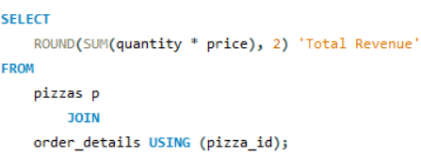
Calculate the total revenue generated from pizza sales.
02

Slide 12
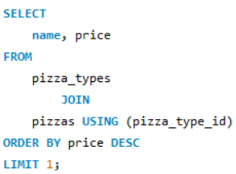
03
Identify the highest-priced pizza.

Slide 13
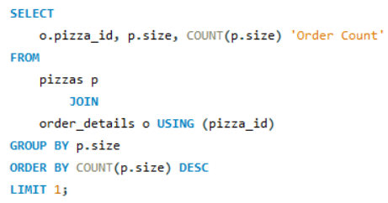
Identify the most common pizza size ordered.
04

Slide 14
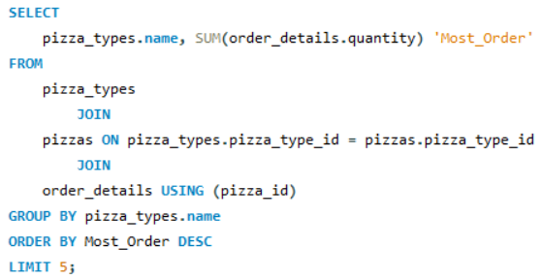
List the top 5 most ordered pizza types along with their quantities.
05

Slide 15
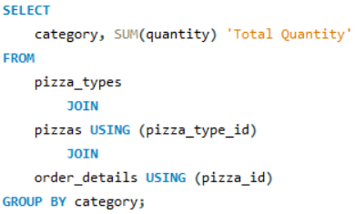
Retrieve the total number of orders placed.Join the necessary tables to find the total quantity of each pizza category ordered.
Intermediate SQL Queries
06

Slide 16
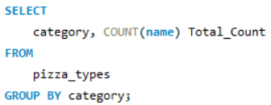
Join relevant tables to find the category-wise distribution of pizzas.
07

Slide 17
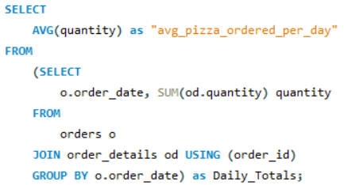
Group the orders by date and calculate the average number of pizzas ordered per day.
08

Slide 18
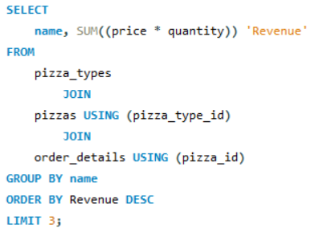
Determine the top 3 most ordered pizza types based on revenue.
09

Slide 19
Advanced SQL Queries

Slide 20
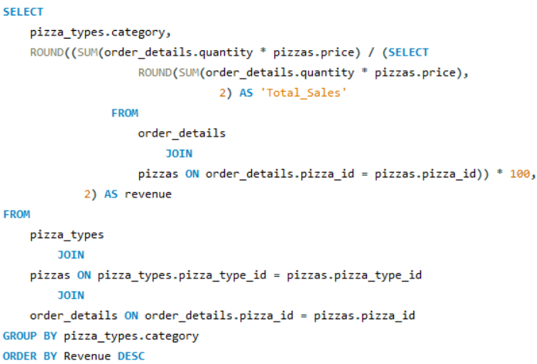
10
Calculate the percentage contribution of each pizza type to total revenue.

Slide 21
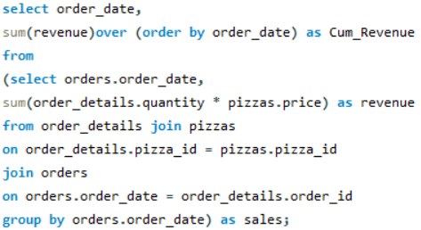
Analyze the cummulative revenue generated over time.
11

Slide 22
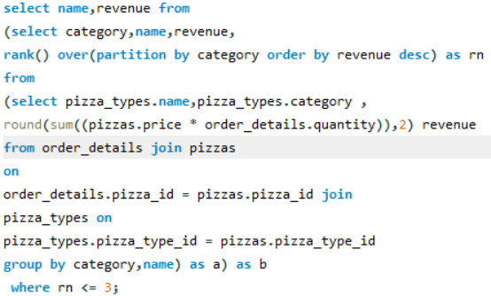
Determine the top 3 most ordered pizza types base on revenue for each pizza category.
12

Slide 23
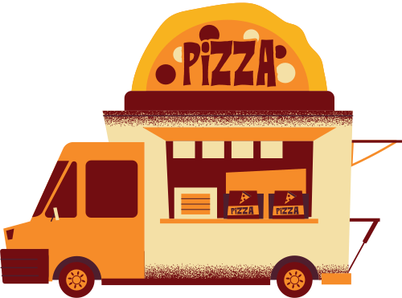
Results and Insights
Sales Patterns
Efficiency Improvements

Slide 24
Sales Patterns
Identify which pizza types are most frequently ordered.
Analyze which types generate the most revenue.
Determine the times of day or days of the week with the highest order volume.
Identify any seasonal patterns affecting order frequency (e.g., increased orders during holidays).
Assess which pizza sizes are most popular among customers.
Examine which ingredients or pizza categories (e.g., classic, gourmet) are favored.

Slide 25
Efficiency Improvements
Track and reduce the time from order placement to delivery.
Efficiently monitor daily, weekly, and monthly sales figures.
Monitor and manage ingredient usage based on pizza orders to avoid overstock or shortages.
Implement automated alerts for low stock levels of ingredients.
Evaluate the impact of promotions and discounts on sales.
Use data insights to adjust the menu, pricing strategies, and product offerings based on customer preferences and sales data.

Slide 26
The Pizza Order Management System has effectively demonstrated how SQL can streamline pizza sales tracking and inventory management. By leveraging a structured database with interconnected tables for orders, pizza details, and ingredients, the project showcases how to manage and analyze sales data efficiently.
Conclusion

Slide 27
Future Enhancements
Real-Time Updates: Integrate real-time data processing to provide up-to-date insights and faster response to trends.
Advanced Analytics: Explore more advanced analytics and machine learning techniques to predict sales trends and customer behavior.

Slide 28
Name: Usman Shaikh
LinkedIn: link
GitHub: link
Email: usmanshaikh8552@gmail.com
Contact Information

Slide 29
Thank You
Your Attention is Appreciated!
Thank you for taking the time to explore the Pizza Order Management System project. Your interest and feedback are invaluable as we continue to advance our data management and analytical capabilities.

